Slide 1
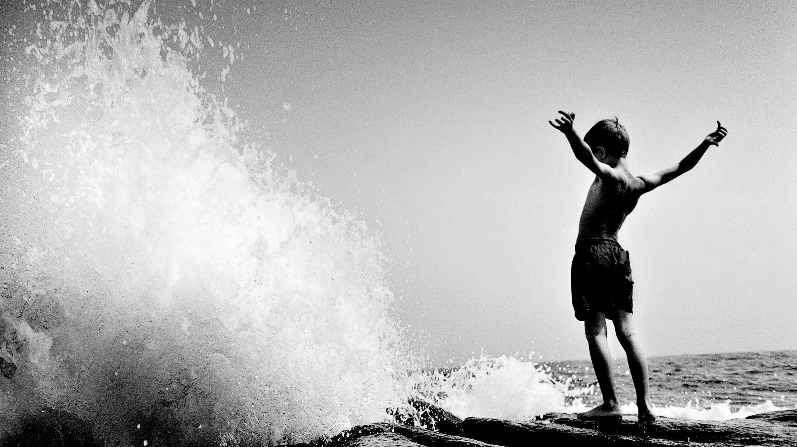
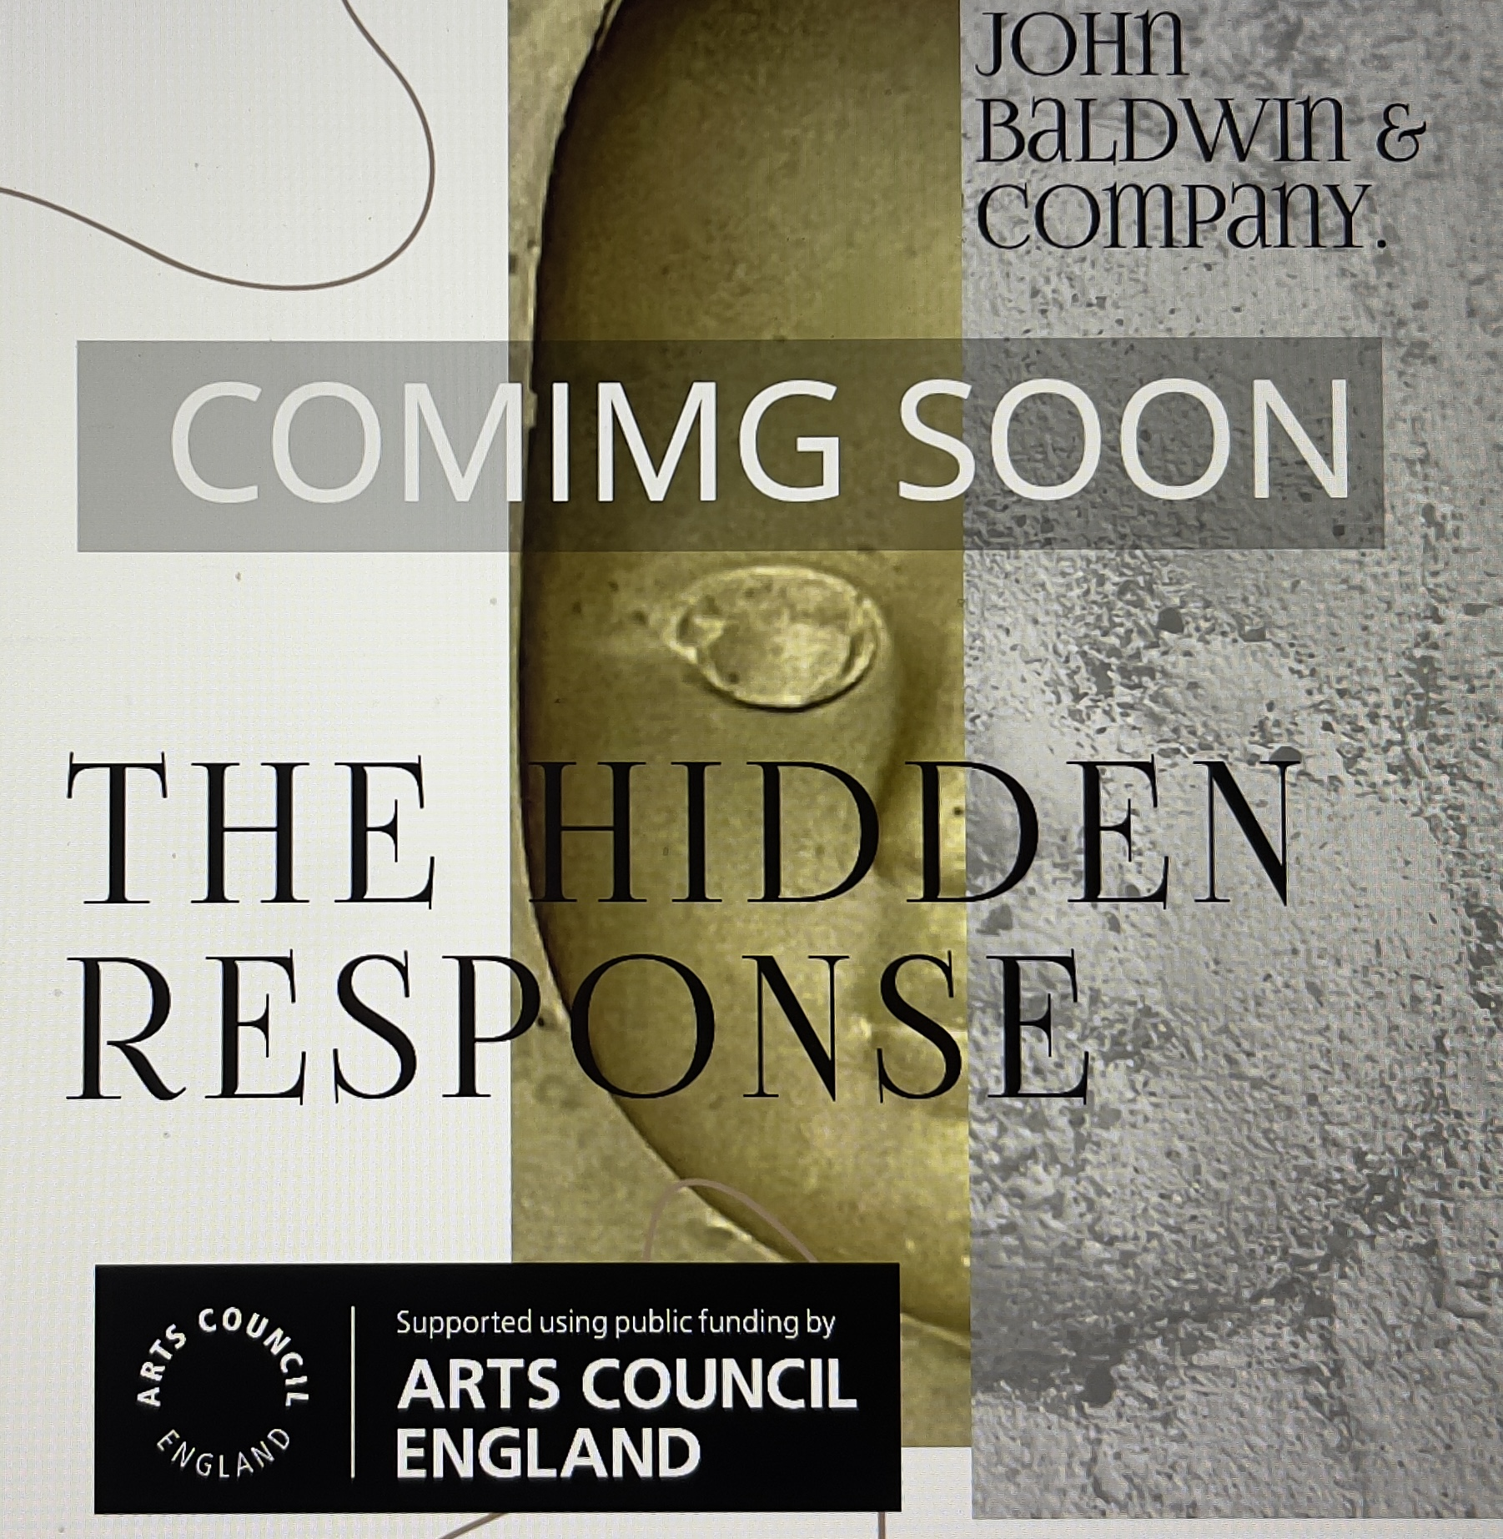
“Allow me to introduce you to the project.”
SO... WE HAVE EXTENDED THE DEADLINE- 01/07/22. 12pm (Midday)
See the website for details.
https://www.thehiddenresponse.com
We would like to introduce you to our Arts Council England funded arts project, which investigates the Hidden Response: the feedback found in the brain when we engage in or consider art. We would like to work with you.
“We intend to explore the Hidden Response, that is to examine the reaction of the brain through EEG (electroencephalogram) and BCI (brain control technologies). exploring the possibilities of genetic disposition in Art, exploring entrainment, pareidolia and other phenomena, this will be achieved both in a gallery and a fringe setting.”

Slide 2
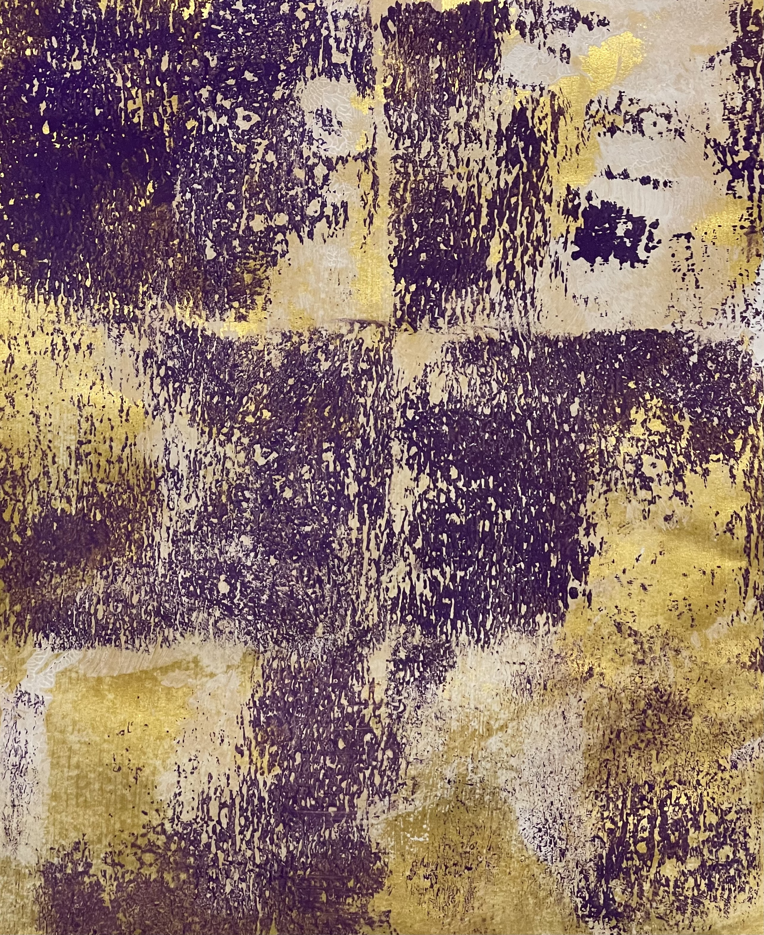
Who, what, why …
MINI REVIEW article
Front. Neurosci., 30 June 2020 | https://doi.org/10.3389/fnins.2020.00692
Brain computer interface is one of the most promising and increasingly popular technologies for assisting and improving communication/control for motor paralysis (e.g., paraplegia or quadriplegia) due to stroke, spinal cord injury, cerebral palsy, and amyotrophic lateral sclerosis (ALS). Eye-tracking technology also allows paralyzed people to control external devices.
The project is the brainchild of lead Artist John Baldwin, an Alumni of Plymouth University a Artist with disabilities. John has Exhibited in collaborative exhibitions at the Venice Biennial, Hamburg Altonale, the Arts institute formally Peninsular arts, and the Tate Liverpool.
Using BCI technology, by Emotiv, a leading EEG headset developer; allows us real-time EEG data and feedback.
Non-invasive EEG-based BCIs can be classified as “evoked” or “spontaneous.” An evoked BCI exploits a strong characteristic of the EEG, the so-called evoked potential, which reflects the immediate automatic responses of the brain to some external stimuli. Spontaneous BCIs are based on the analysis of EEG phenomena associated with various aspects of brain function related to mental tasks carried out by the BCI user at their own will.
… & WELLNESS.
BCI-induced brain plasticity might contribute to the treatment of high-order cortical dysfunctions, such as improving social and emotional behaviours in autism spectrum disorder (Amaral et al.), training inhibitory control and working memory in ADHD, as well as contributing to the rehabilitation of cognitive deficits related to dementia. Moreover, BCI-based brain training can help preserve cognitive performance in healthy older adults, promoting successful aging and reducing the social burden of the population's increasing aging. BCIs are also used to establish closed-loop control of brain sensing and stimulation technology to improve, for example, tremor, or to provide sensation.
EDITORIAL article
Front. Neurosci., 16 December 2020 | https://doi.org/10.3389/fnins.2020.598247

Slide 3
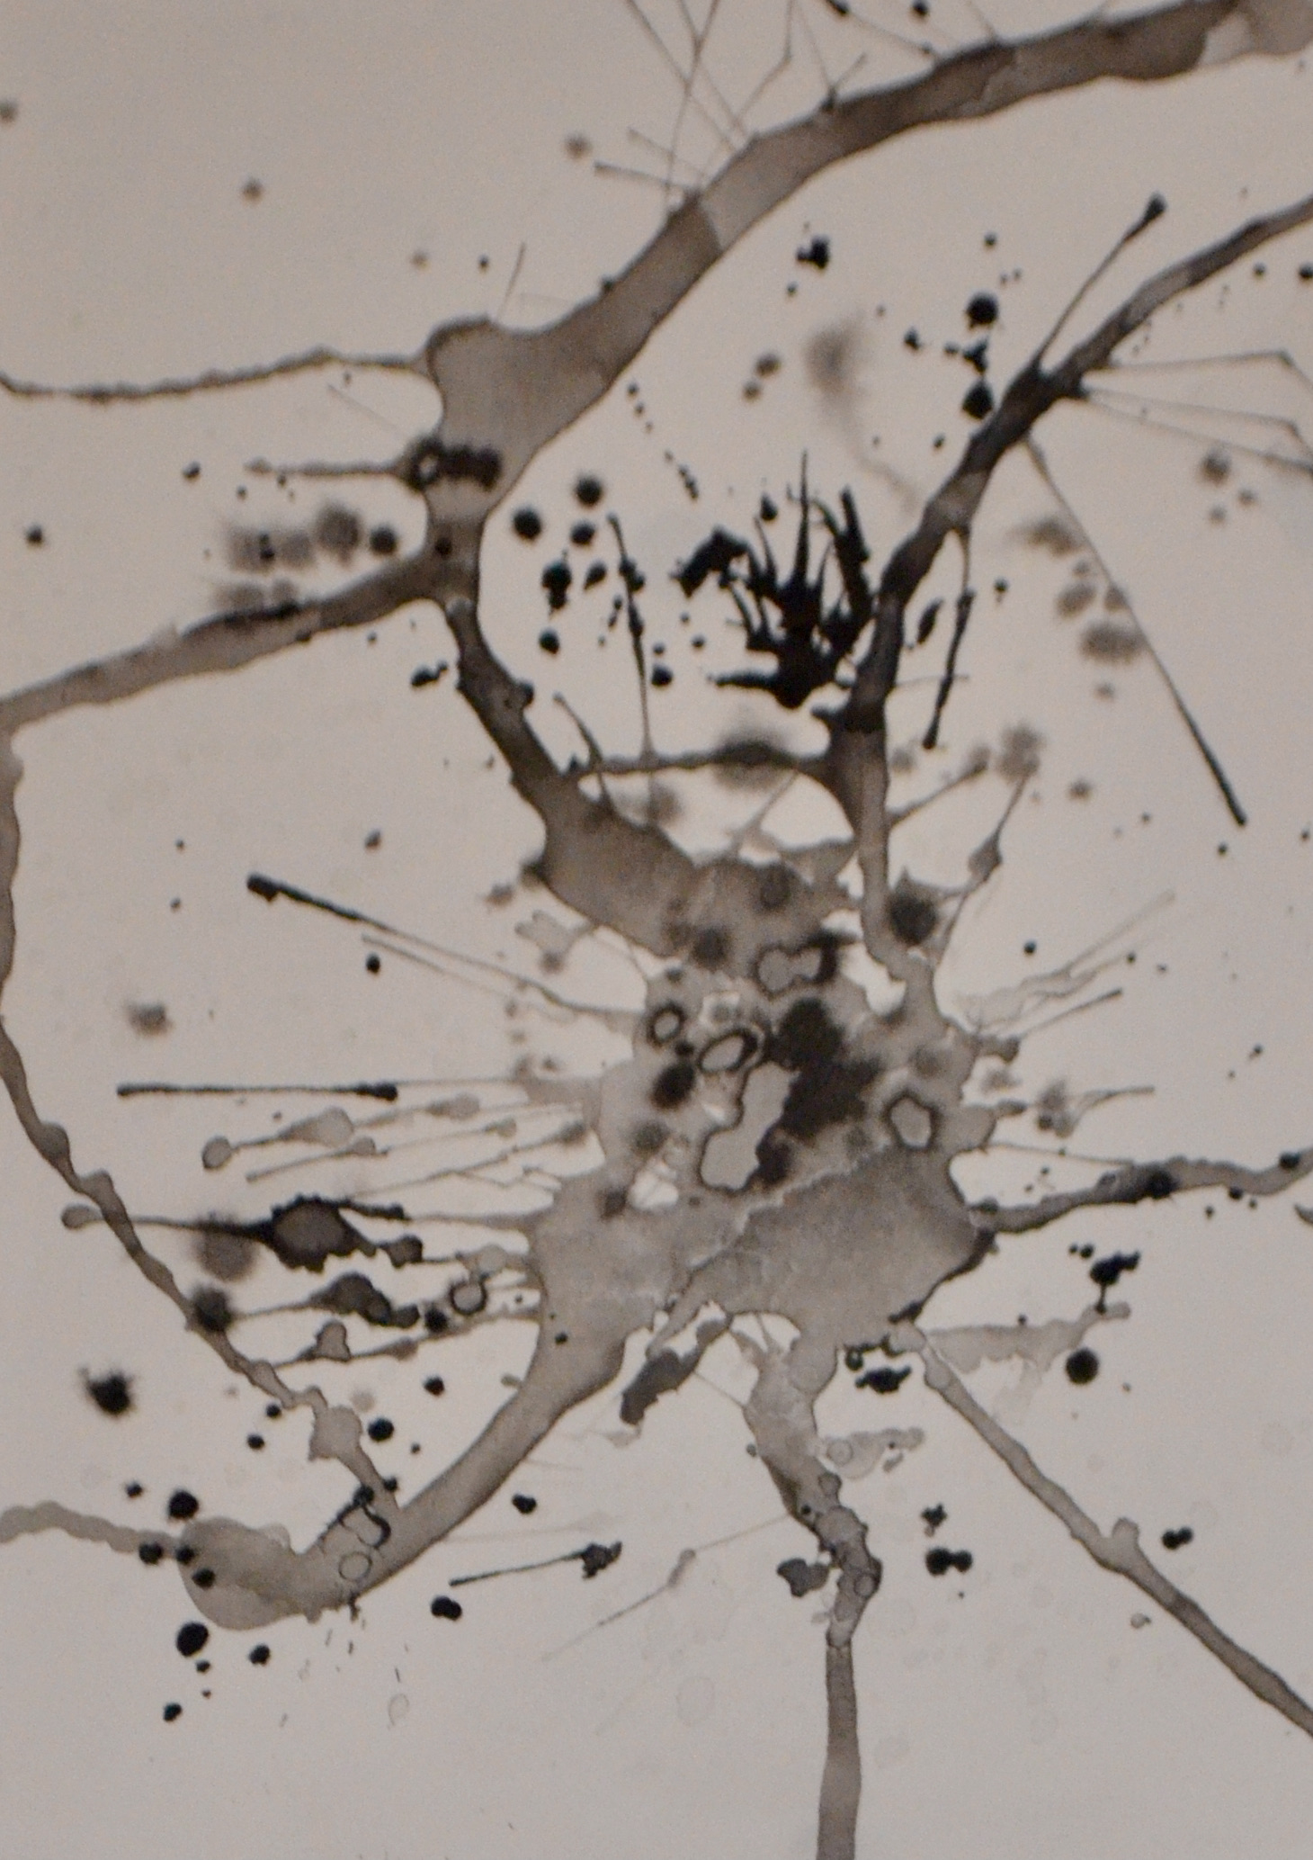
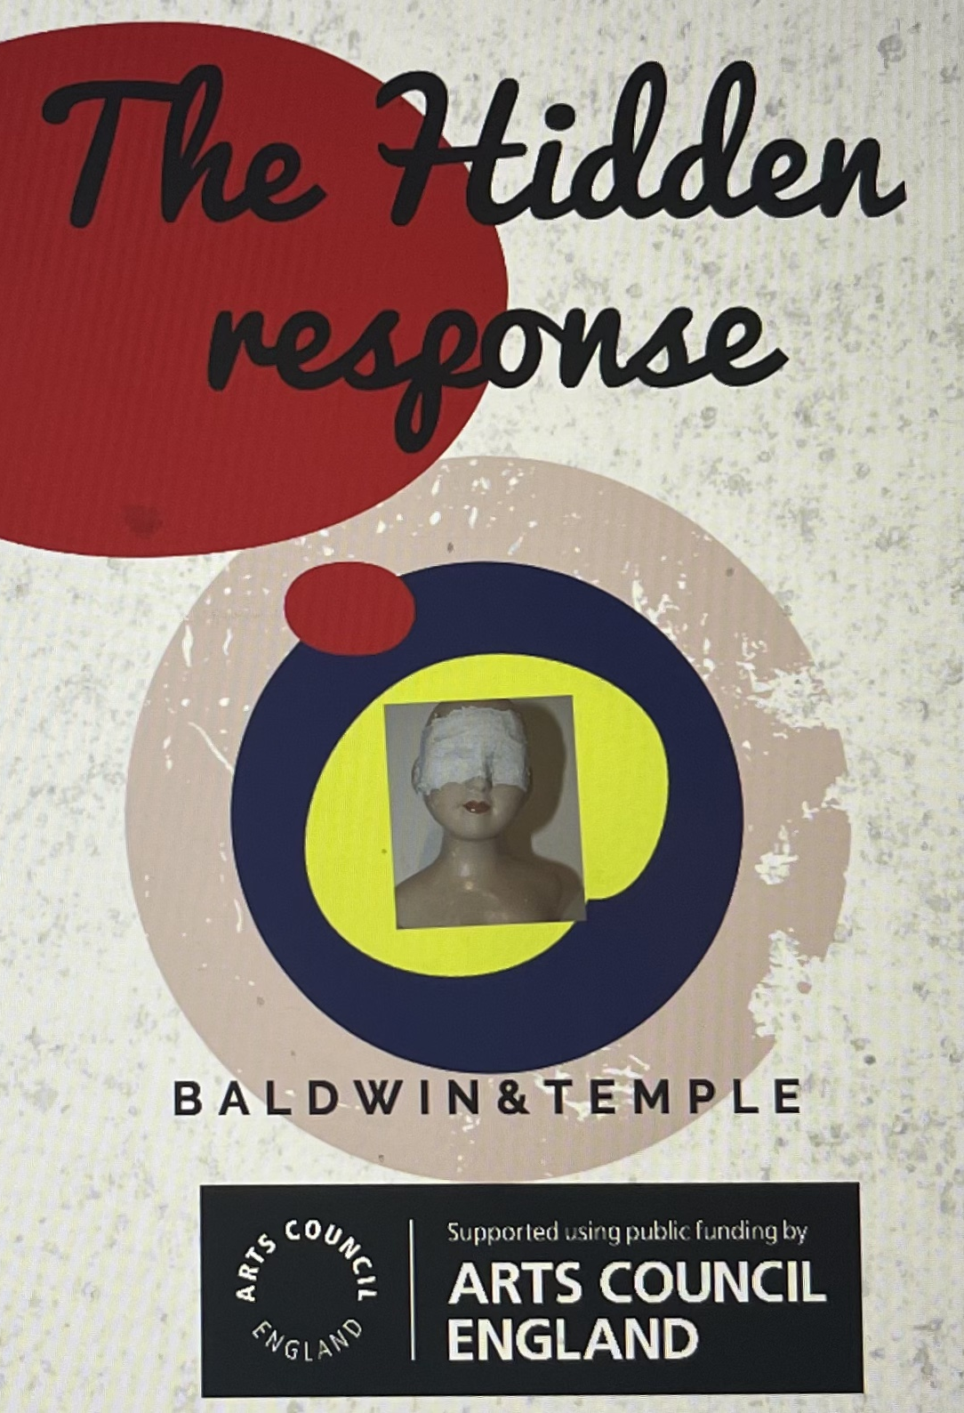
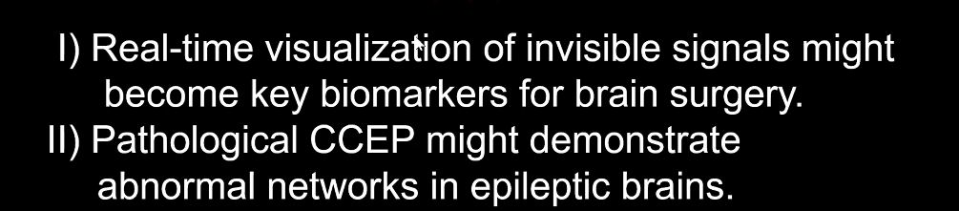
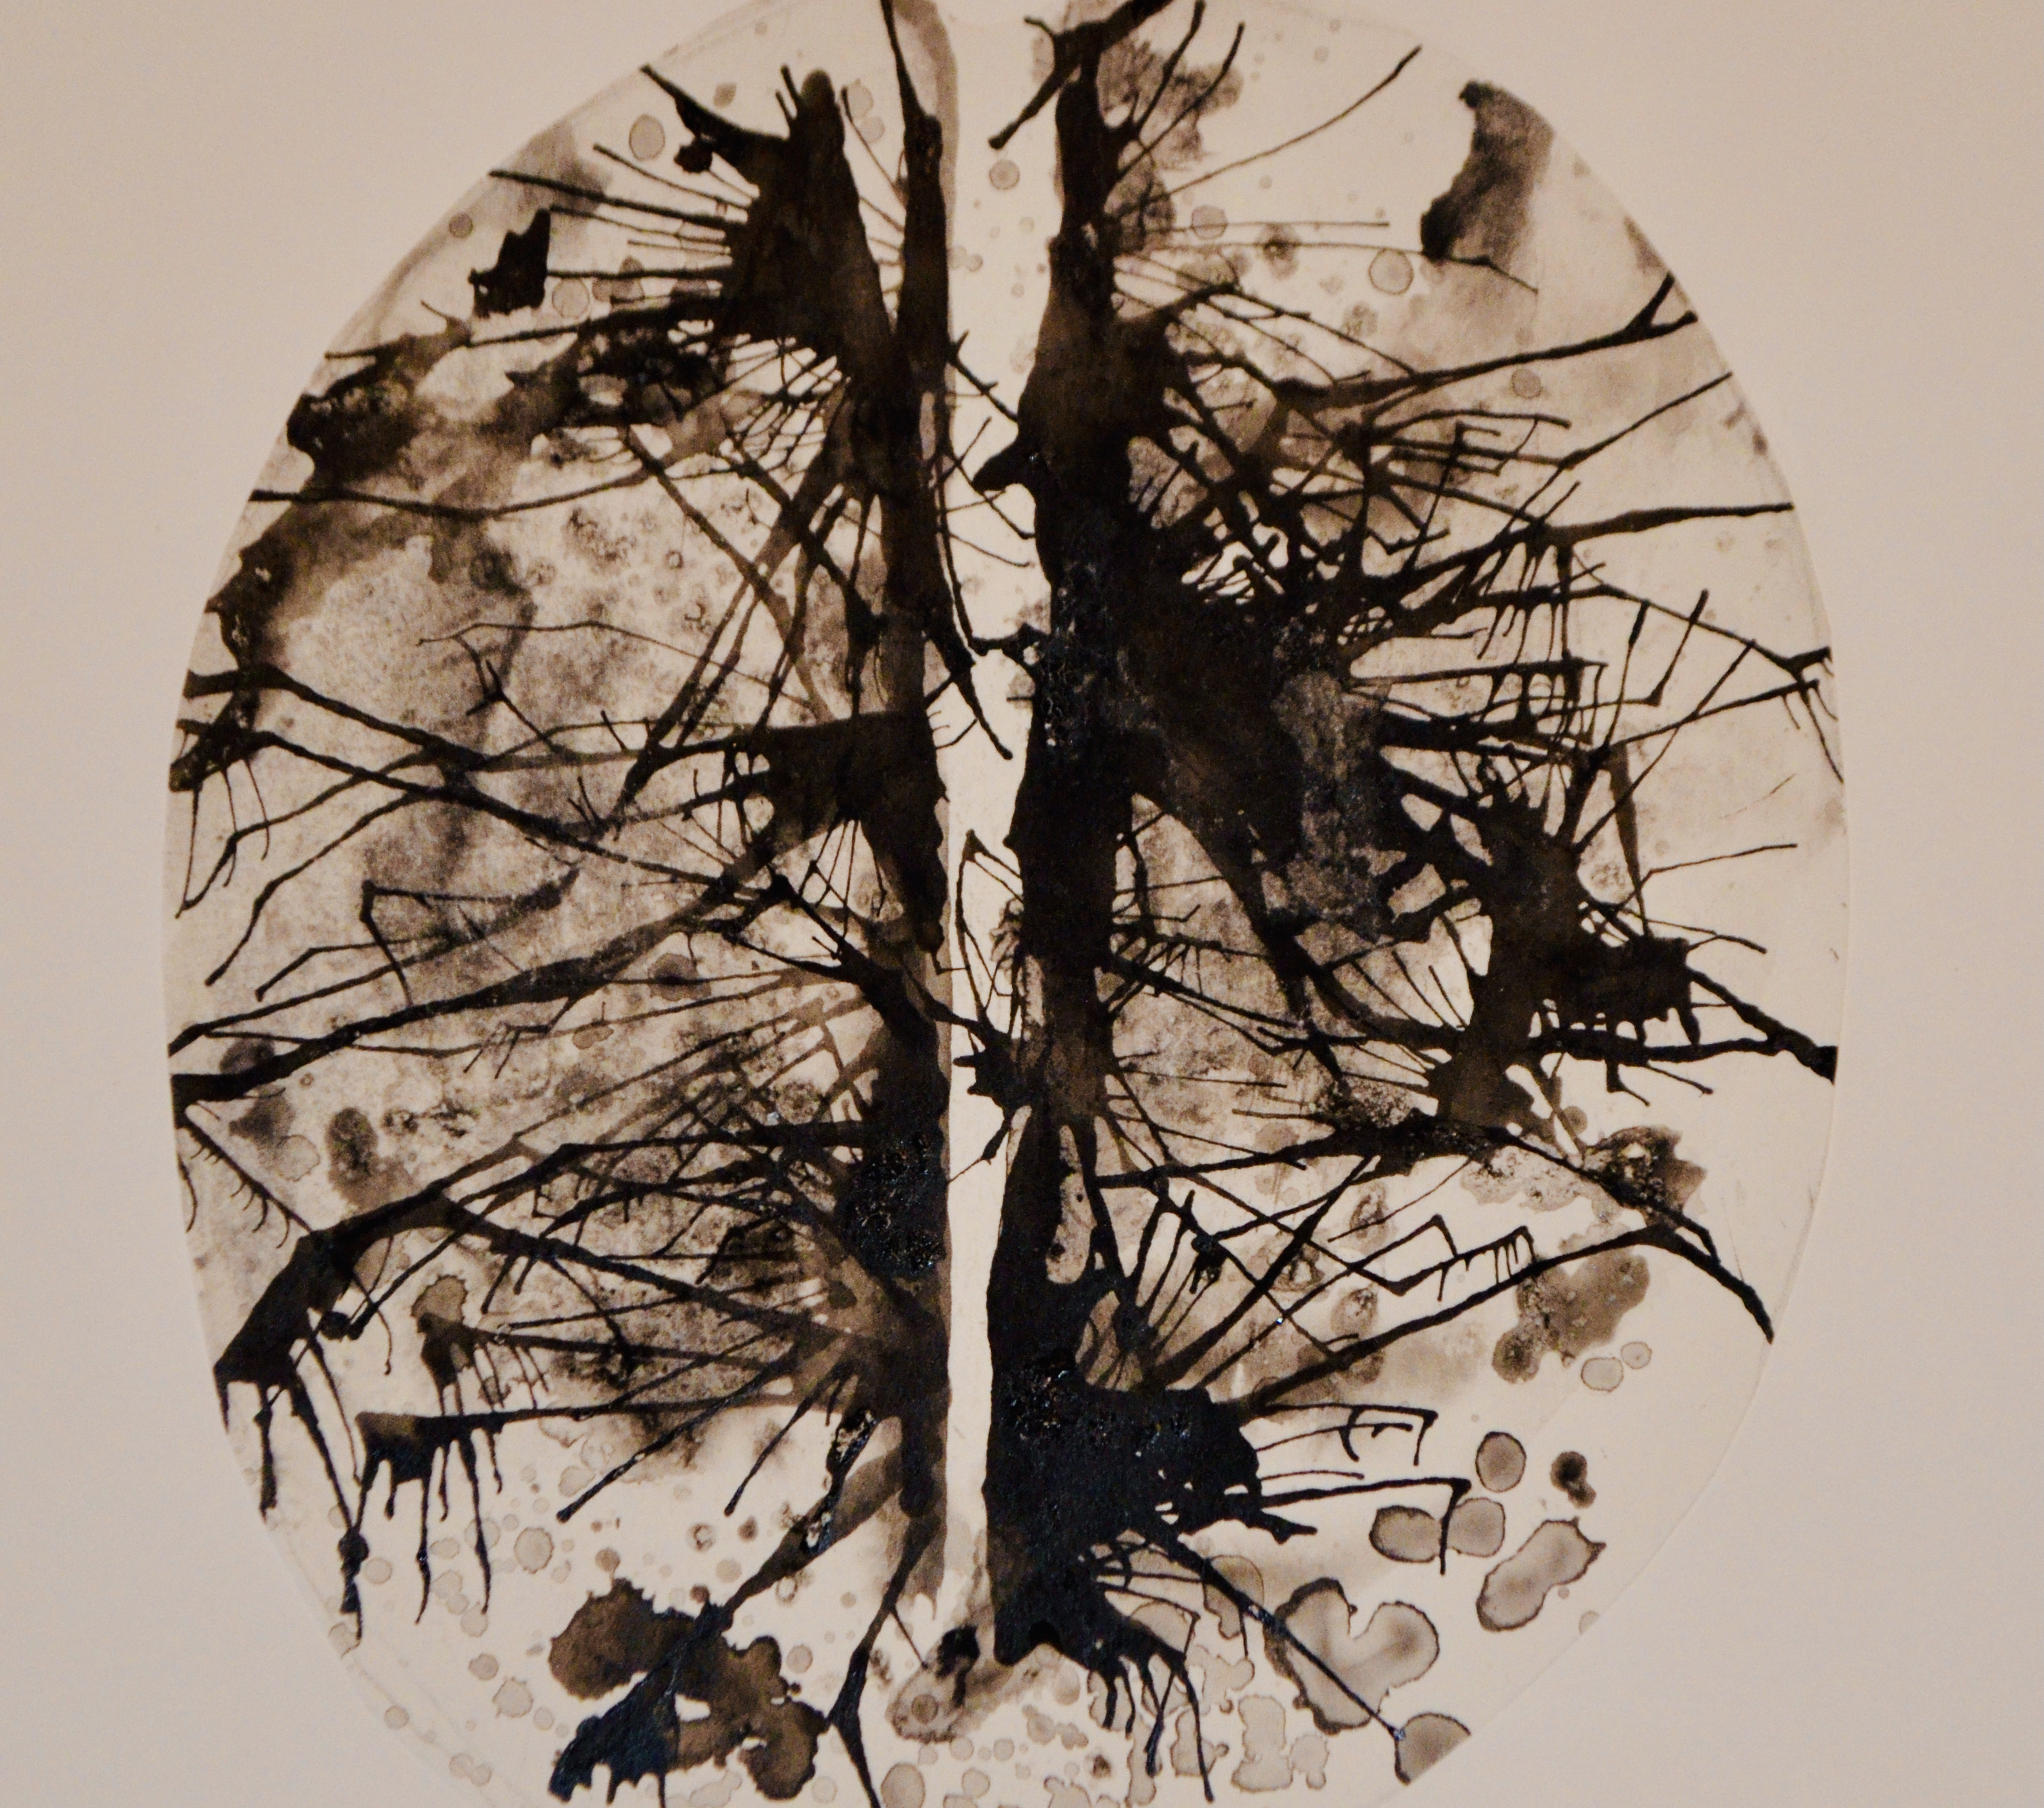
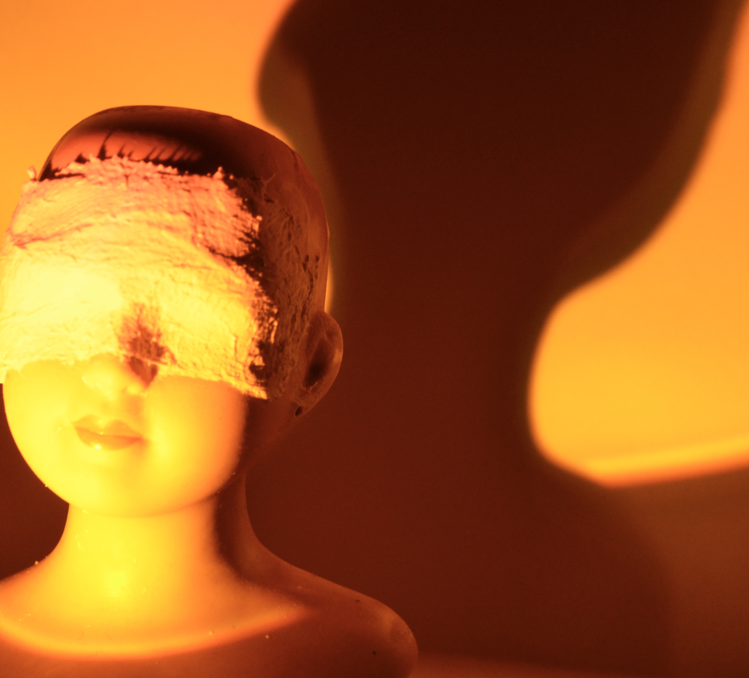
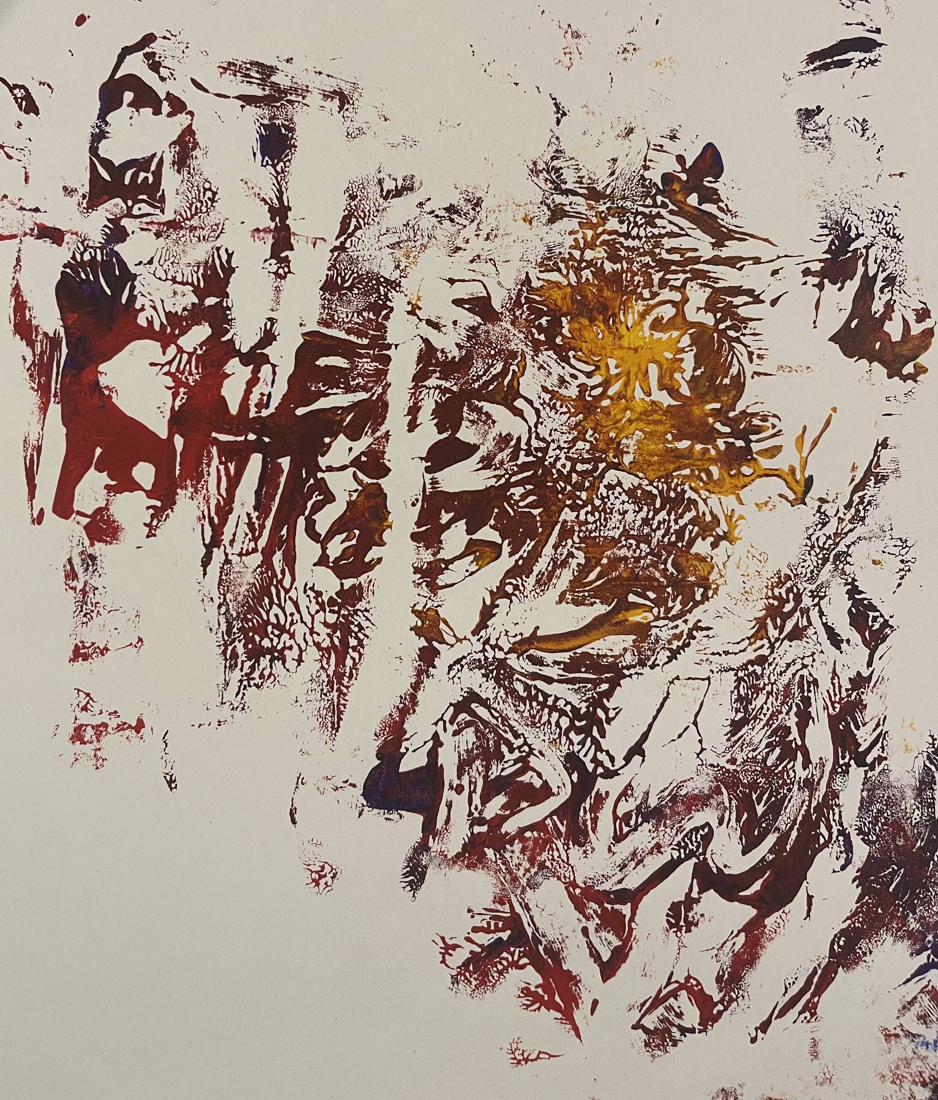
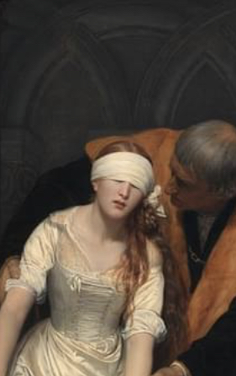
In 1960, Isidore Isou created supertemporal art: a device for inviting and enabling an audience to participate in the creation of a work of art. In its simplest form, this might involve nothing more than the inclusion of several blank pages in a book, for the reader to add his or her own contribution. A work shop we plan to visit whilst using BCI.
Pataphysics….
In the 1960s 'pataphysics was used as a conceptual principle within various fine art forms, especially Pop art and popular culture. Works within the pata-physical tradition tends to focus on the processes of their creation, and elements of chance or arbitrary choices are frequently key in those processes. Select pieces from the artist Marcel Duchamp and the composer John Cage characterize this. At around this time, Asger Jorna pata-physician and member of the Situationist International, referred to 'pataphysics’ as a new religion.

Slide 4

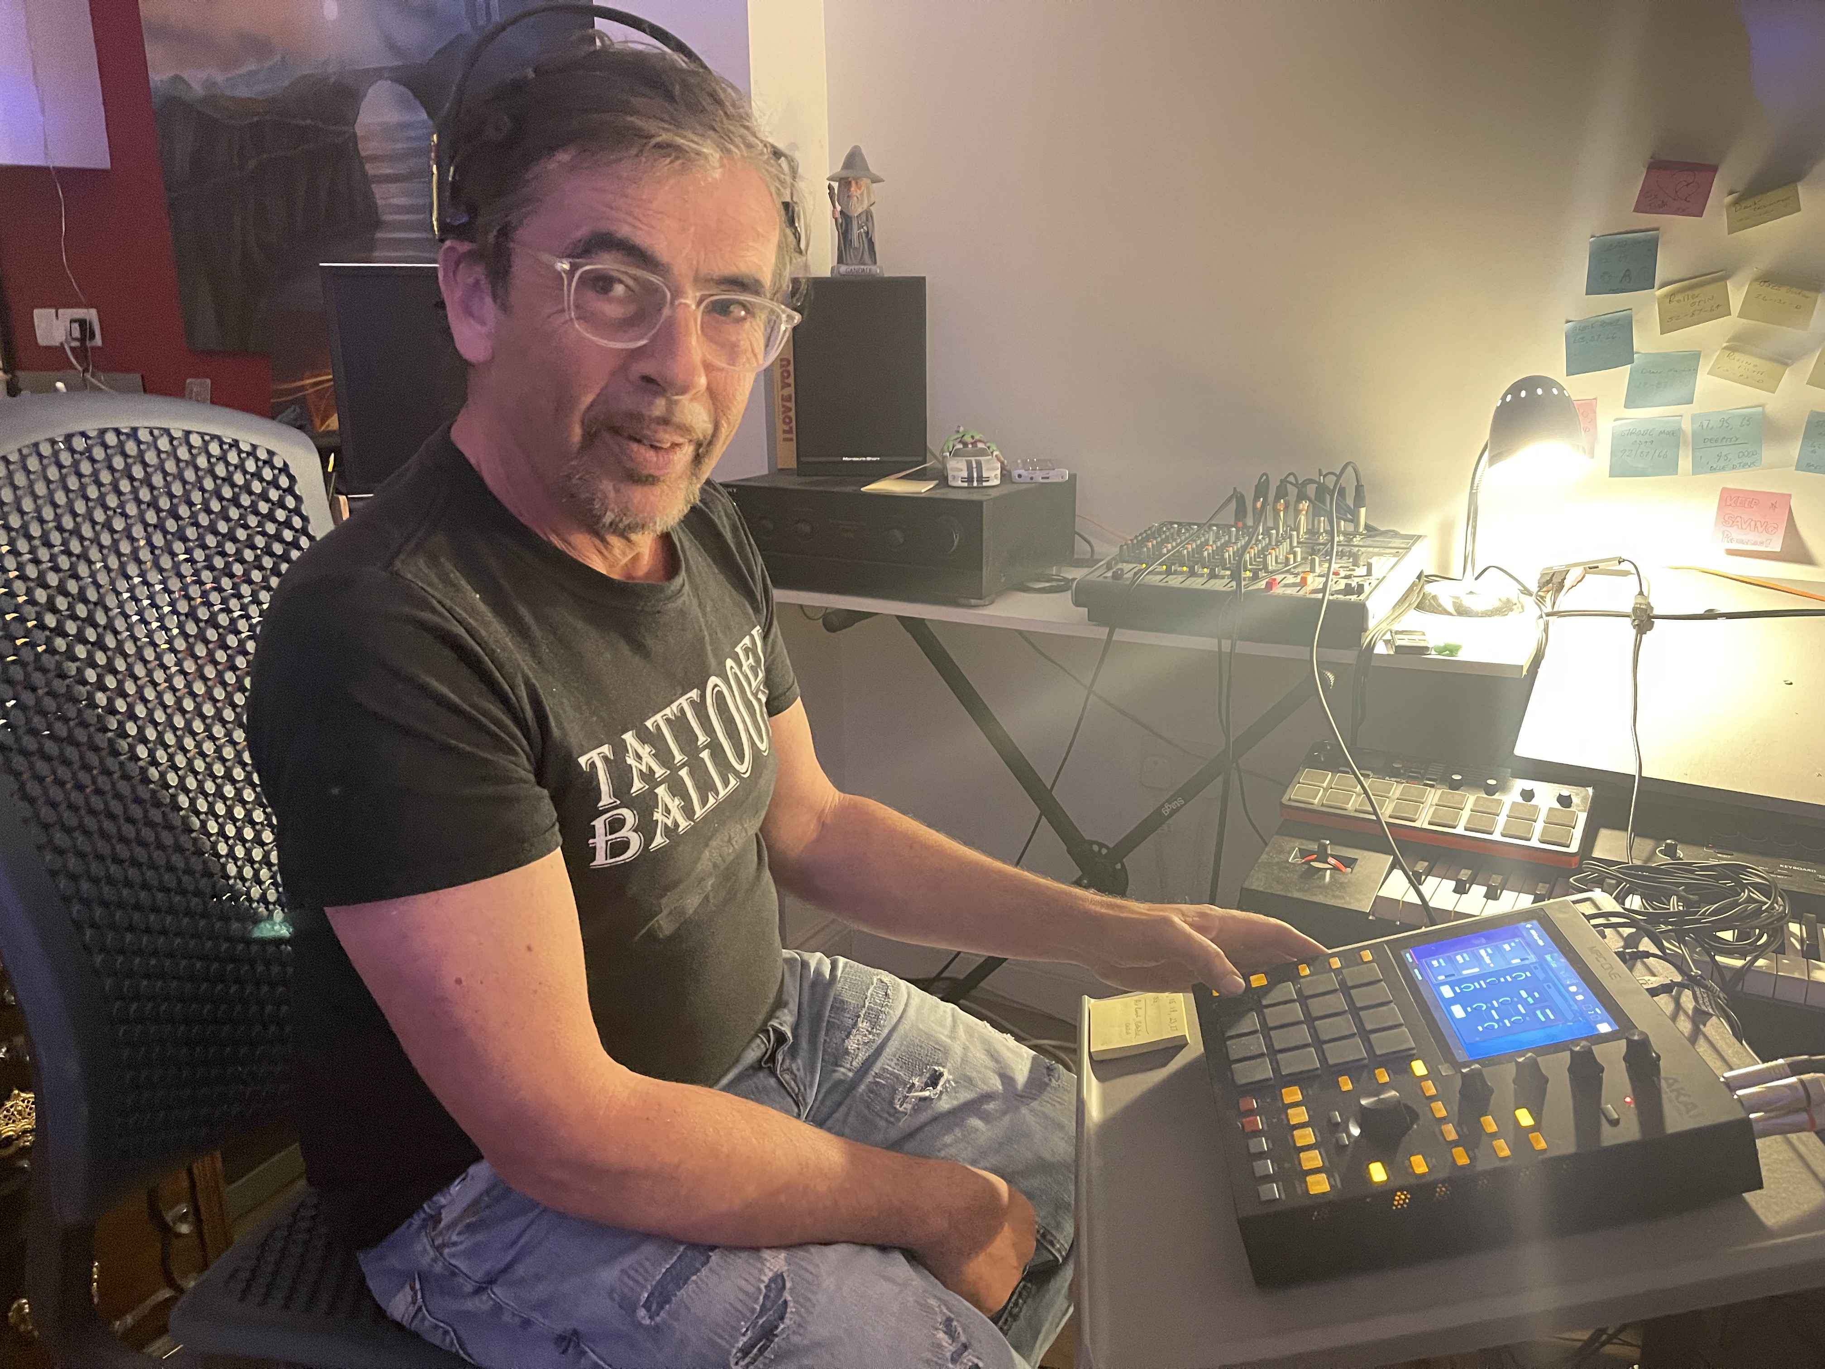
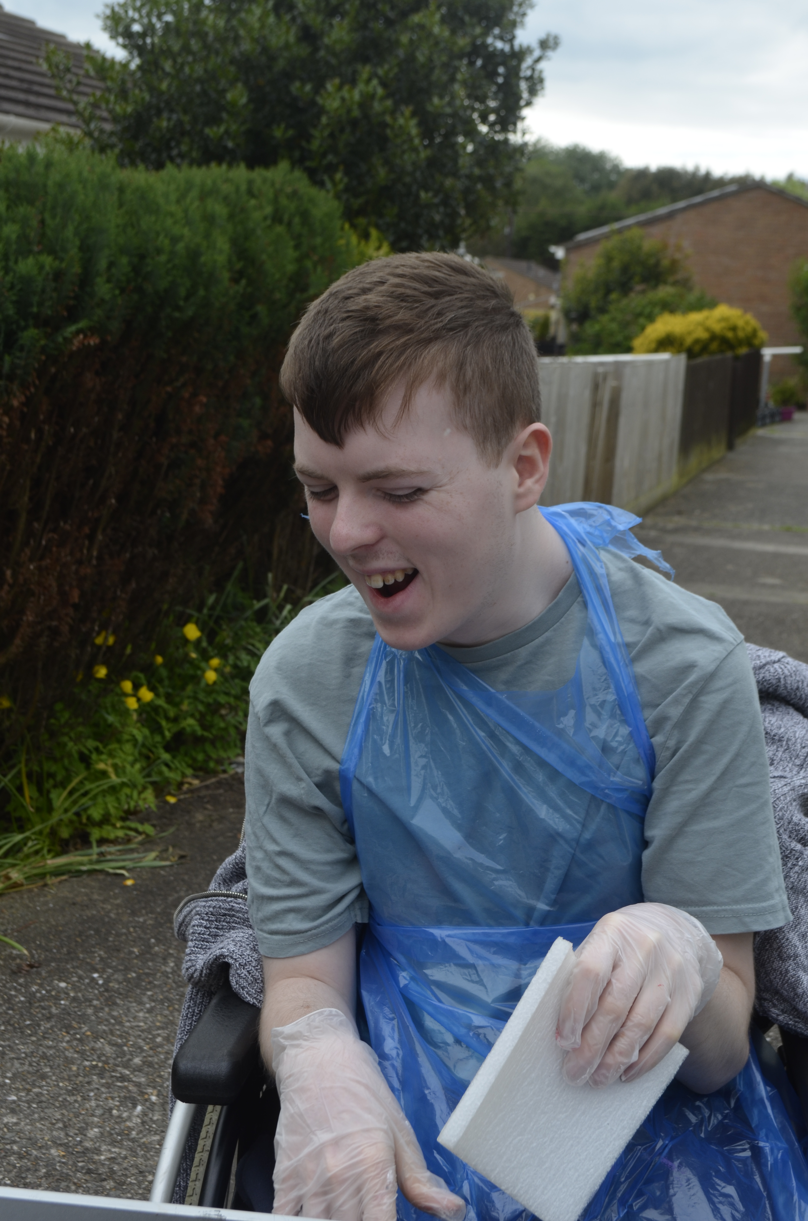
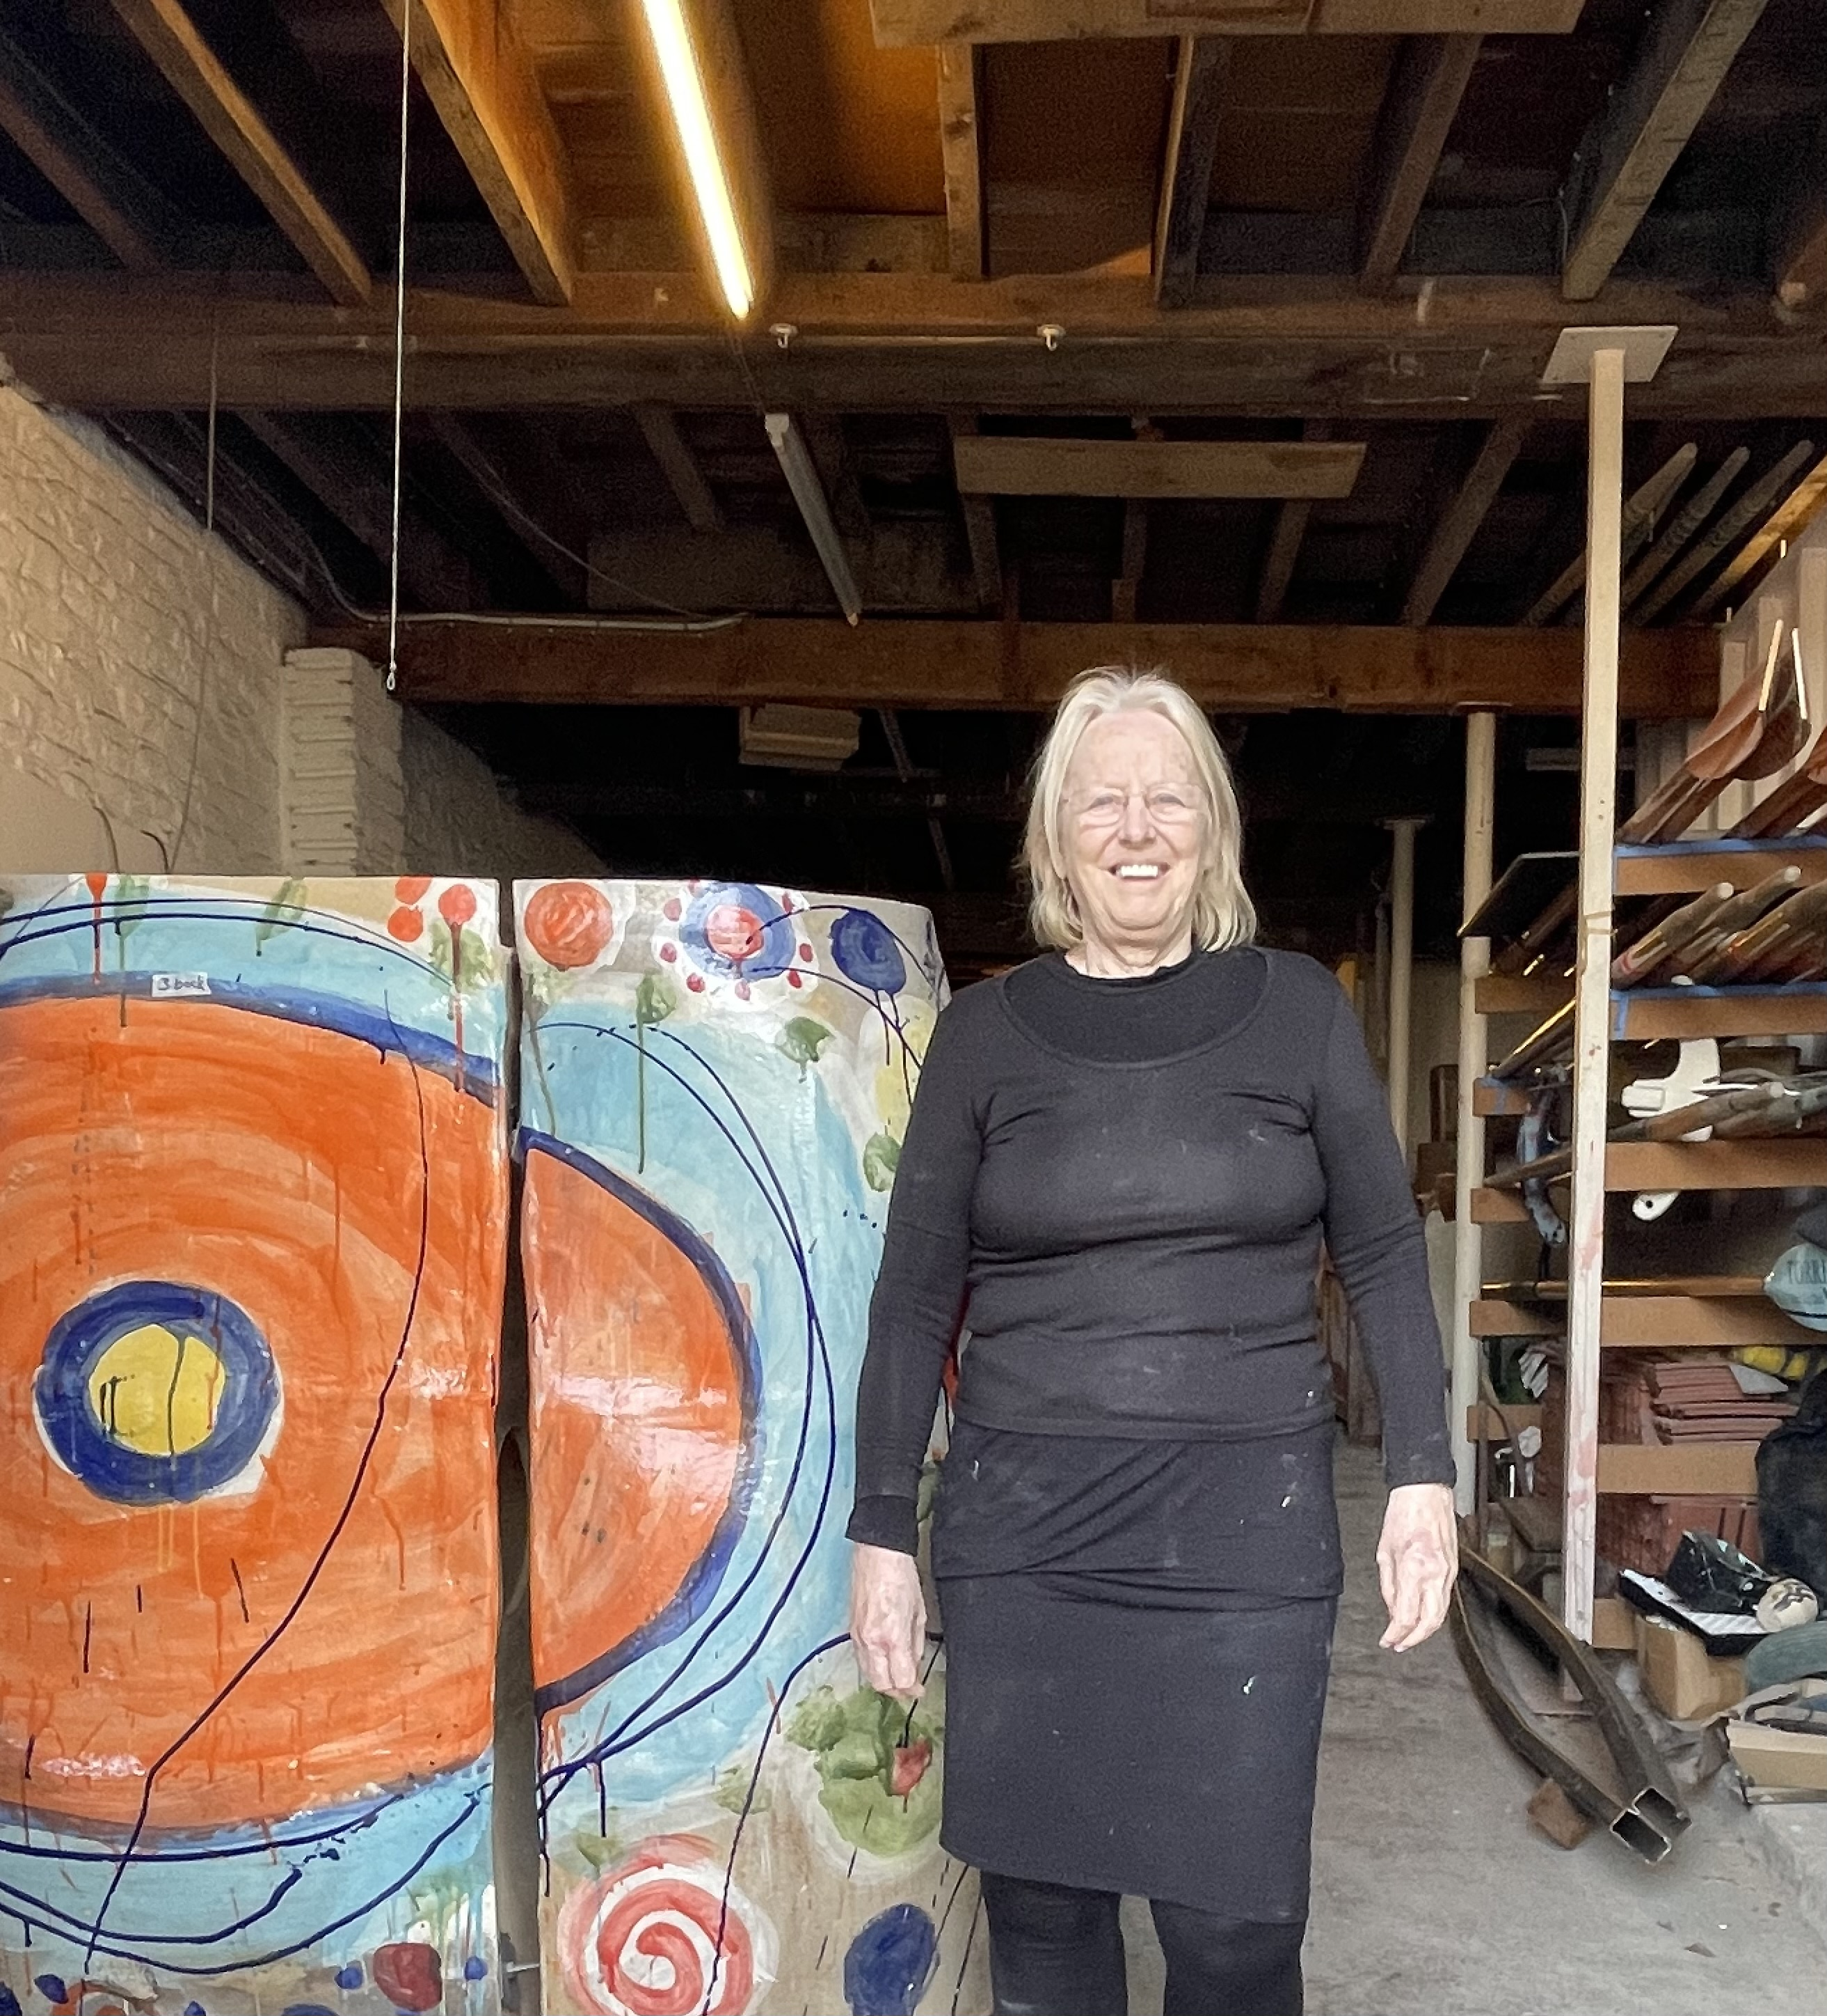

Fellow collaborators
Simon Cox of Tattooed Balloon in his studio.
I snapped a reaction to my plans I think he answered , “…you want to do what…?”
Oliver who loves music and has been working with me on joint pieces of work and some of his own Art. Through out my DCPF.
Oliver is Blind and has Cerebral Palsy he loves the work we do, although.. he can find it somewhat messy.
Another International Artist has shown interest however wishes to remain anonymous at present.
International Artist Sandy Brown. Has agreed to have her brain scanned in early July on only one condition that I do as well Whilst we are talking.
https://www.contemporaryceramics.uk/makers/sandy-brown/

Slide 5
This includes to be able to post on the Website during the project as well as access to my digital portfolio with links to the project.
How can you get more involved?
I’m glad you asked. Contact Us. On the submit/application button. On the Website.-
Things done for the project.
Things still need to be Done!
THE HIDDEN RESPONSE.
Gouache
Tell us what you are doing and why?
Oil Painting.
Developed Talks thinking about the cross overs.
Pareidolia
photography
Developed workshops
Interventions
Writing
Visited Tate Liverpool
Unconscious mind
New
Art
Neuroplasticity
Attended spring school 22 of
THE INSTITUTE OF NEUROAPPROACHES LLC (and got a certificate) go us!
Poems
Sound workshops in development
Entrainment
Visited Tate Modern
Film
Neuroaesethics
neurological
Spray Painting

Slide 6
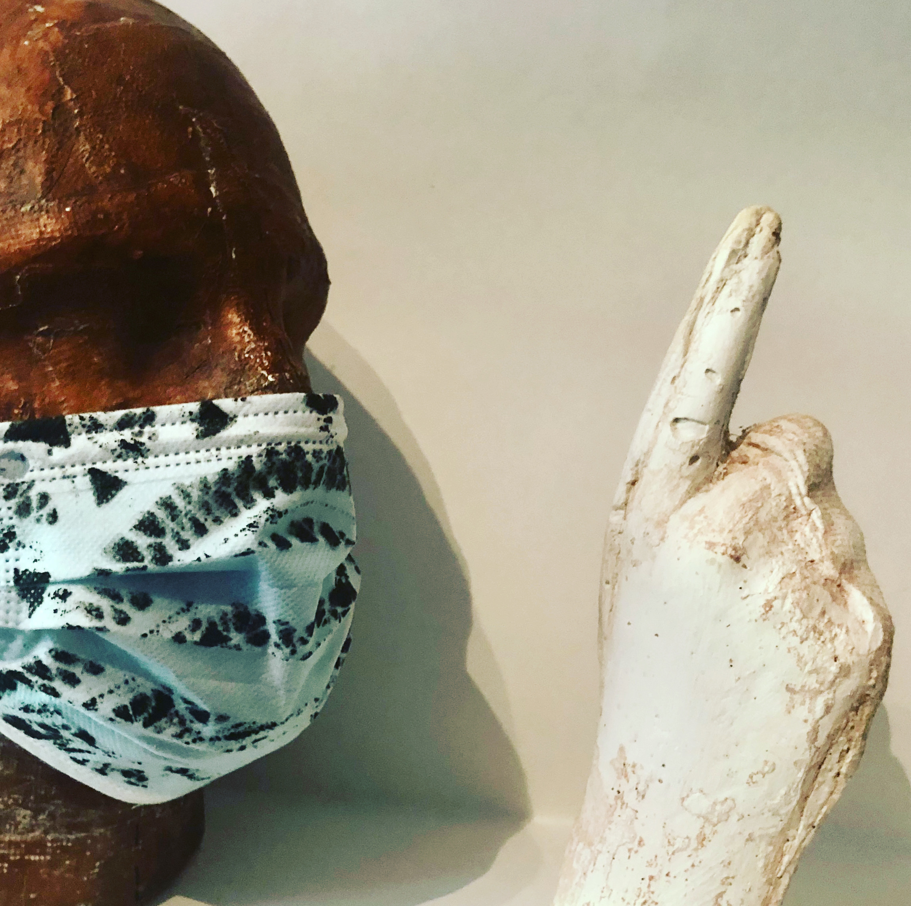
The Hidden Response needs you.
For what is art without participation.
The Project.
How Creative are You? We would like you to join us. With a possibility to have your Brain be the subject to our research. Also, to spend a day with artist John Baldwin AKA CRACKEDPAINTER and the team. Making art and scanning your hidden response learning about new techniques mixed with some old.

Slide 7
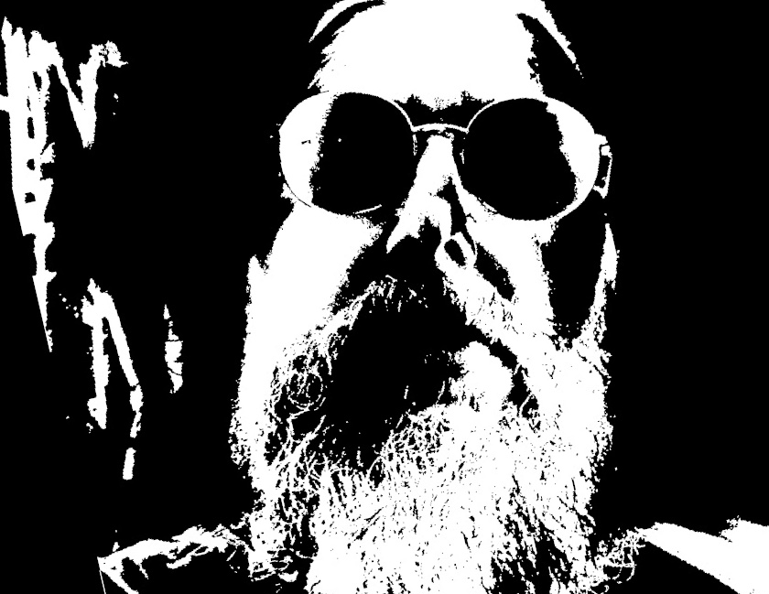
“Thank you! For taking the time to read the slides and We hope to see you in our Research and Artistic project. I look forward to your responses.”
‘The difference between science and the arts is not that they are different sides of the coin… or even different parts of the same continuum, but rather, they are manifestations of the same thing. The arts and sciences are avatars of human creativity.’
Mae Jemison, Ted Talks, http://www.ted.com/speakers/mae_jemison
With out further ado, drum roll

Slide 8
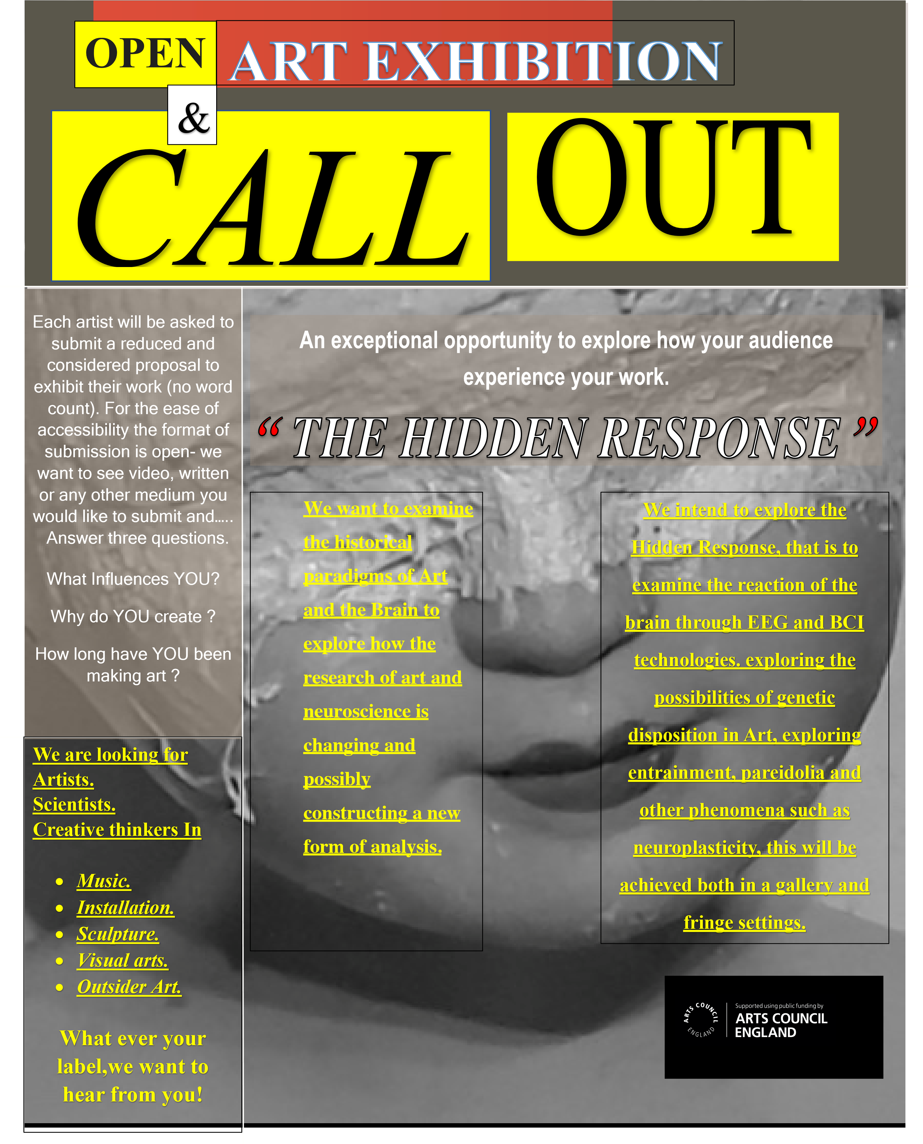
The culmination of a fascinating project into neuroplasticity and Neuroaesethics.
Poster created for
THE HIDDEN RESPONSE
Will your name be here?

Slide 9
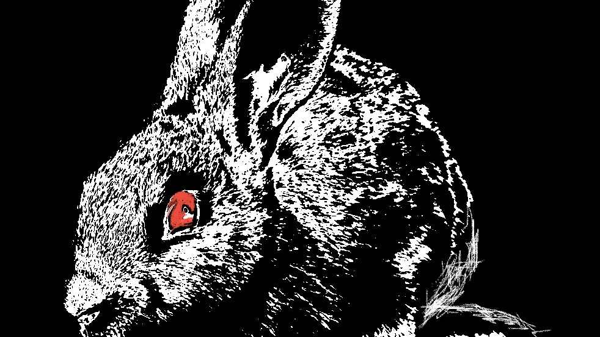
Should you get to the end of this project proposal and think its ambitious. I would totally agree…
The Hidden Response.
I have a cunning plan!
HOWEVER, THIS IS BRITISH ART

Slide 10
We know the journey not the destination.
THE HIDDEN
RESPONSE .

